Slide 1
LINKED LIST
Notes:
https://www.w3resource.com/c-programming-exercises/linked_list/index.php
http://www.ggu.ac.in/download/IT/Inf%20Tech%20Pankaj%20Chandra%20B%20Tech%20%20IV%20Data%20Structure%20-%20Model%20Answer.pdf

Slide 2
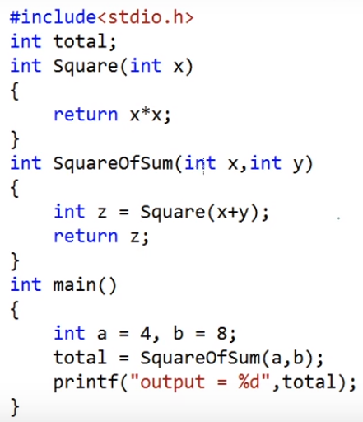
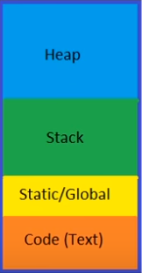
Dynamic memory allocation
STACK
Application’s memory
Function calls and local variables
Global and static data
Instructions
GLOBAL
Notes:
https://www.youtube.com/watch?v=_8-ht2AKyH4

Slide 3
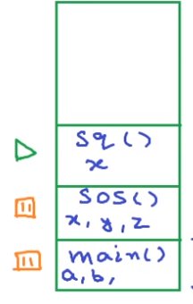
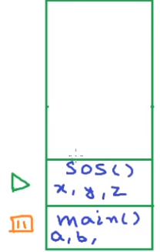
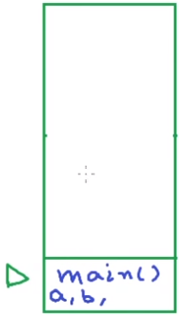
STACK FRAME
total
total
total
Global
Global
Global

Slide 4
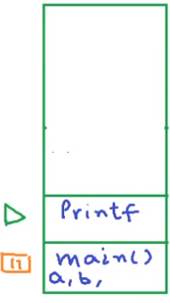

stack
stack
OS allocates some amount of space for stack at compile time but stack frames and local variables are allocated at run time
If stack grows beyond the reserved space (eg: bad recursion), stack overflow occurs because stack cannot grow at run time
total
Global
Global
Unlike stack, heap is not fixed. Its size can vary during the lifetime of the application. A programmer can totally control how much memory to use from heap.
Notes:
We should assign a variable global only if is needed at multiple places in multiple functions and needed for whole lifetime of the program otherwise it is just waste of memory

Slide 5
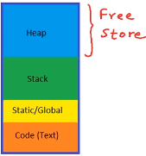

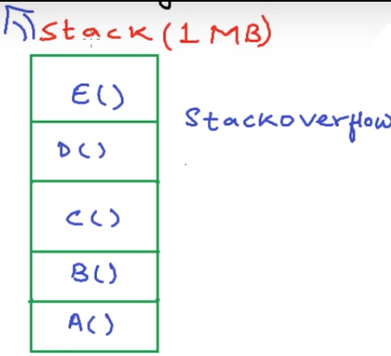
malloc
calloc
realloc
free
Heap is also called dynamic memory and using the heap is referred to as dynamic memory allocation

Slide 6
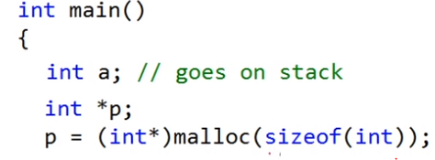

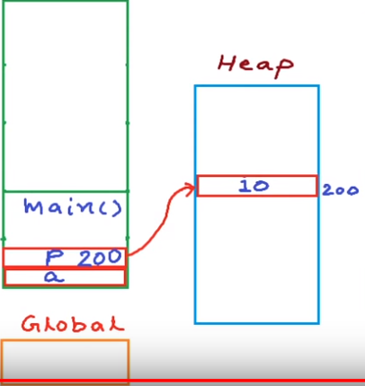

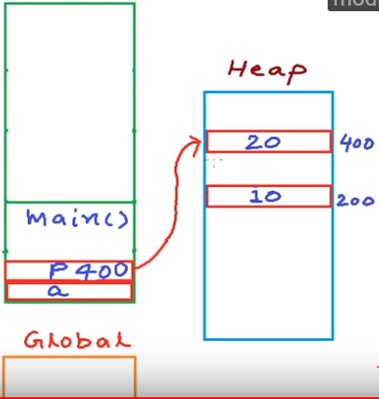
Clear the memory using free

Slide 7

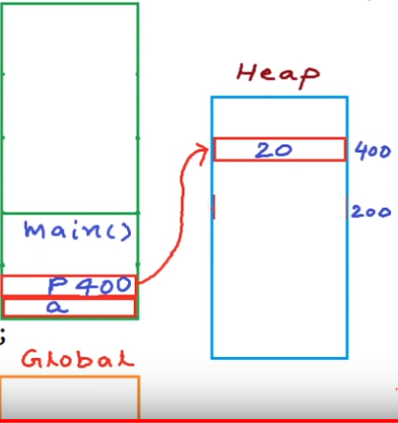
?

Slide 8
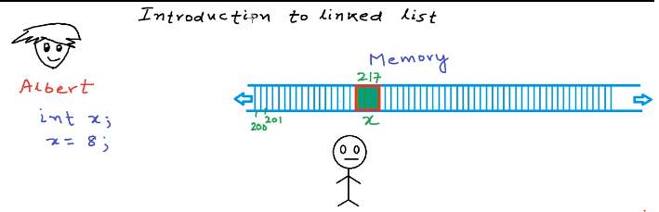
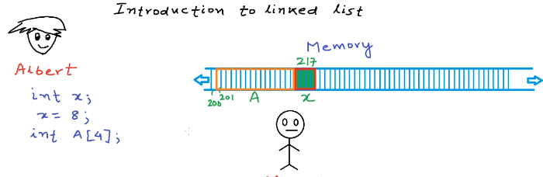
Storing an integer value in memory,
int x=8;
Memory Manager
Storing a list of numbers in memory: Using array we can store list of number of same type, array is always stored as one contiguous block of memory
Memory Manager

Slide 9
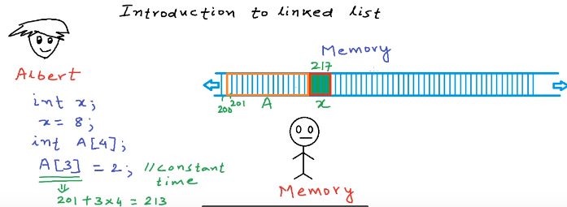
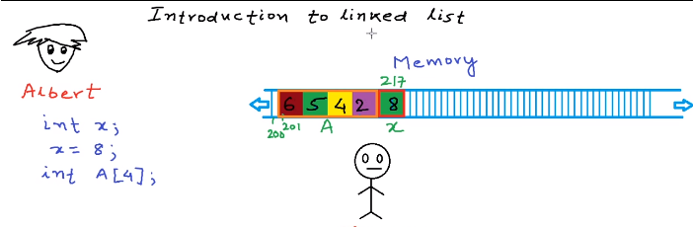
Irrespective of the size of arrays, an application can access any of the elements in array in constant time(Random access)
Memory Manager
Storing elements in array: a[0]=6; a[1]=5; a[2]=4; a[3]=2;
Memory Manager

Slide 10
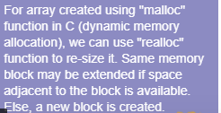
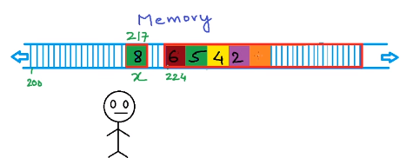
Now, adding one more element to the array won't be possible in the same location, therefore the array is copied to a different memory area where the sufficient space is available
Memory Manager
Memory Manager
Creation of entirely new array is costly. Solution to this problem is linked list data structure
Creation of entirely new array is costly. Solution to this problem is linked list data structure
Memory Manager

Slide 11
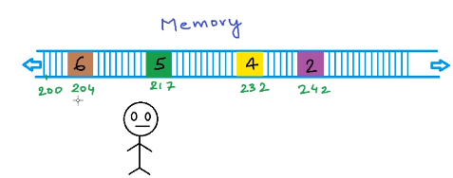
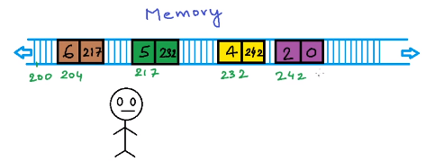
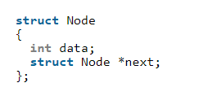
If we request for one element at a time, instead of getting one contiguous block of memory we get these disjoint, non-contiguous block of memory
Memory Manager
Now we need to link these newly created blocks. To link these blocks, we store some extra information with the block.
Memory Manager
Request MM for 2 blocks where 1st block stores the value and other variable stores the address of the next block in order to create a link

Slide 12
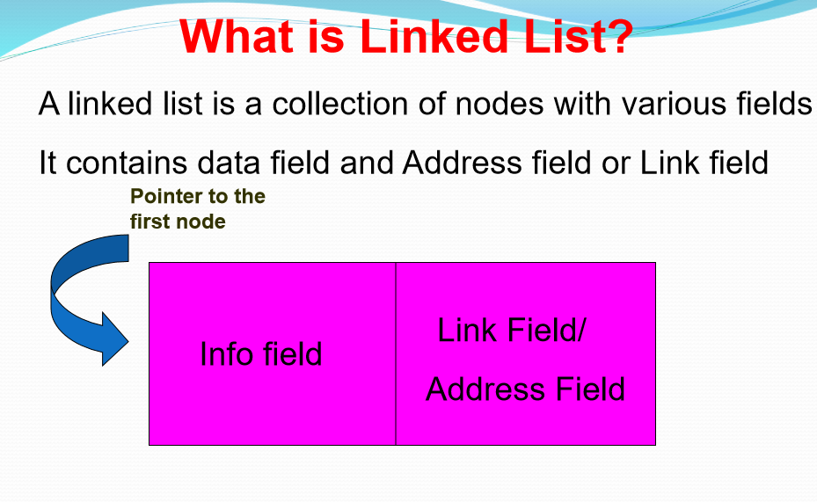

Slide 13

Linked List vs Array
Both Arrays and Linked List can be used to store linear data of similar types, but they both have some advantages and disadvantages over each other.
Following are the points in favor of Linked Lists.
(1) The size of the array is fixed: So we must know the upper limit on the number of elements in advance. Also, generally, the allocated memory is equal to the upper limit irrespective of the usage, and in practical uses, upper limit is rarely reached.
(2) Inserting a new element in an array (sorted) of elements is expensive, because room has to be created for the new elements and to create room existing elements have to shifted.
Linked lists have following drawbacks 1) Random access is not allowed. We have to access elements sequentially starting from the first node. So we cannot do binary search with linked lists. 2) Extra memory space for a pointer is required with each element of the list.
Logical representation of linked list. Each node stores the data and address to the next node. First node also called as head node and the only information about the list that we keep all the time is address of the first node. The address of the last node is null.

Slide 14
linked list vs array
Dynamically allocating an array of size 4 to this heap area will not be possible because contiguous block of 16 bytes is not available here.
Dynamically allocating an array of size 4 to this heap area will not be possible because contiguous block of 16 bytes is not available here.
HEAP MEMORY(every block represents 4 byte and white color block represents free space)
But, Allocating a linked list of size 4 to this heap area will be possible

Slide 15
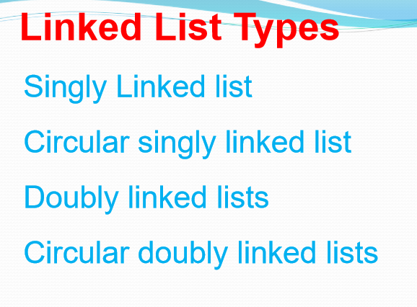

Slide 16
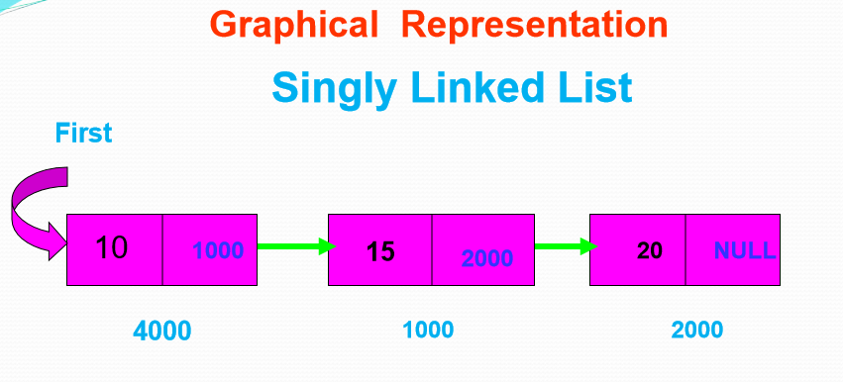

Slide 17
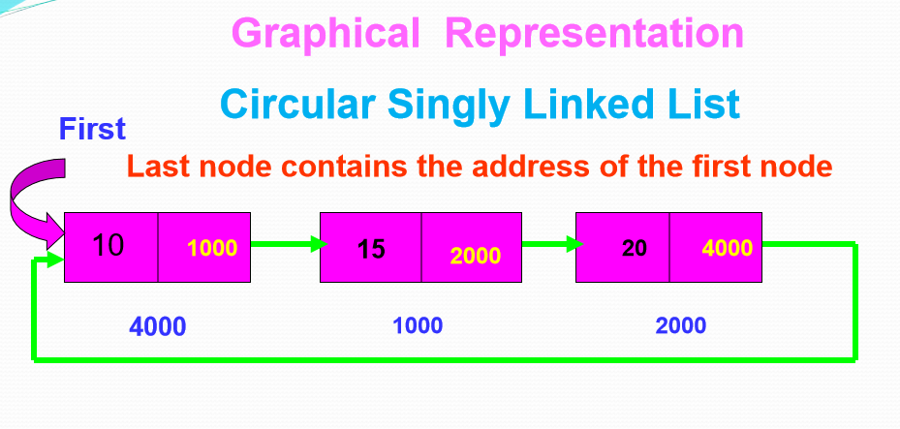

Slide 18
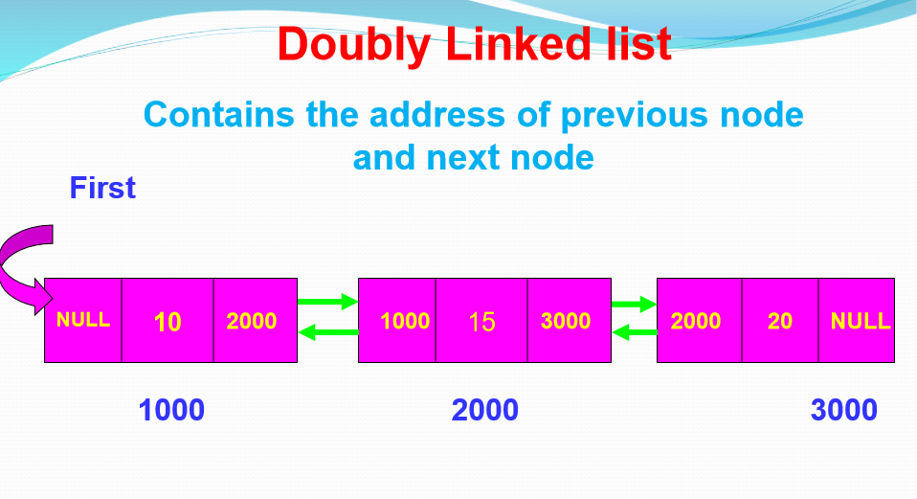

Slide 19
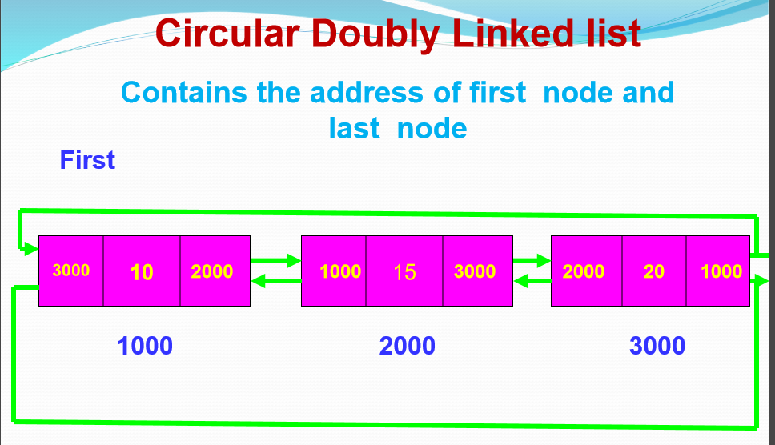

Slide 20
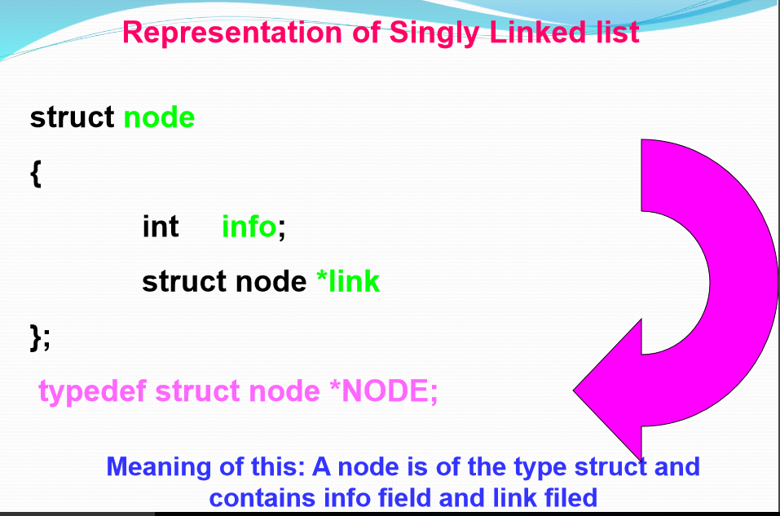

Slide 21
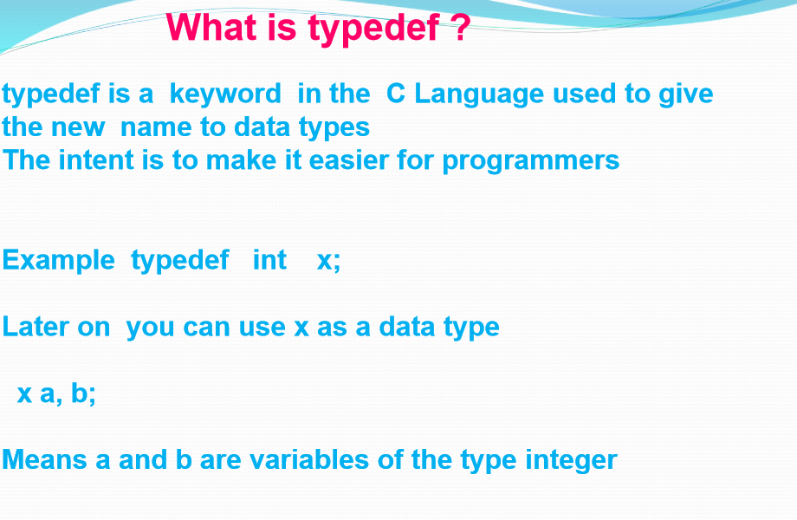

Slide 22
Linked list operations
Insert at the beginning of the linked list
Insert at the end of the linked list
Insert at the given position of the linked list
Delete from the beginning of the linked list
Delete from the end of the linked list
Delete from the given position of the linked list
Search an element in a given linked list
Reversing a linked list
Merging two linked list
Traversing of linked list

Slide 23
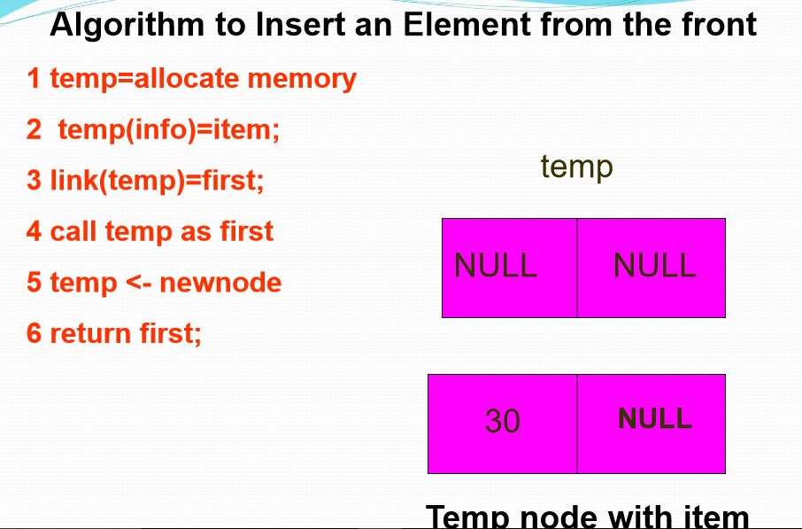

Slide 24
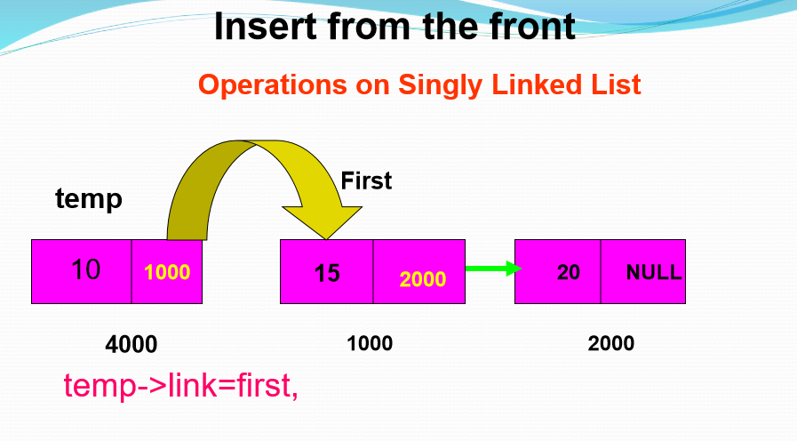

Slide 25
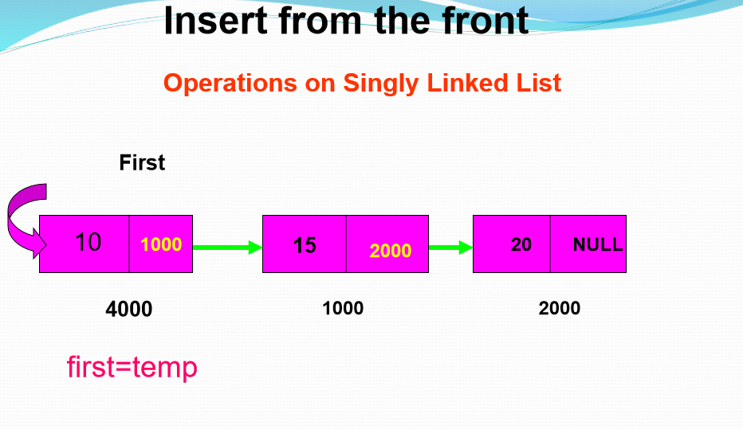

Slide 26
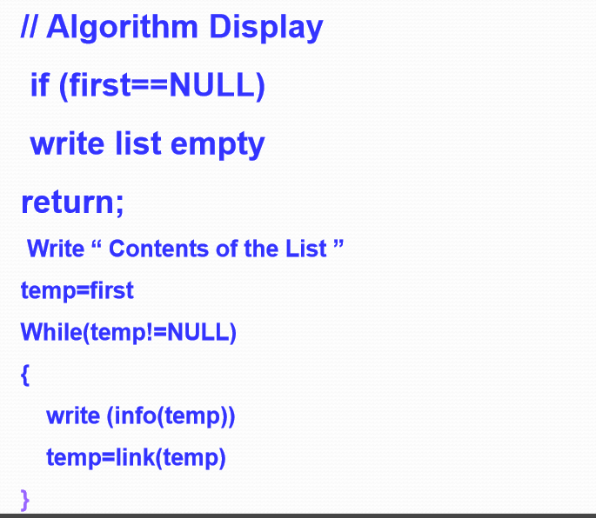
Algorithm to Display the content

Slide 27
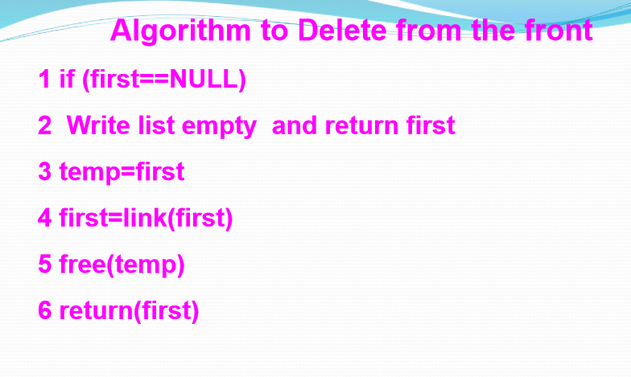

Slide 28
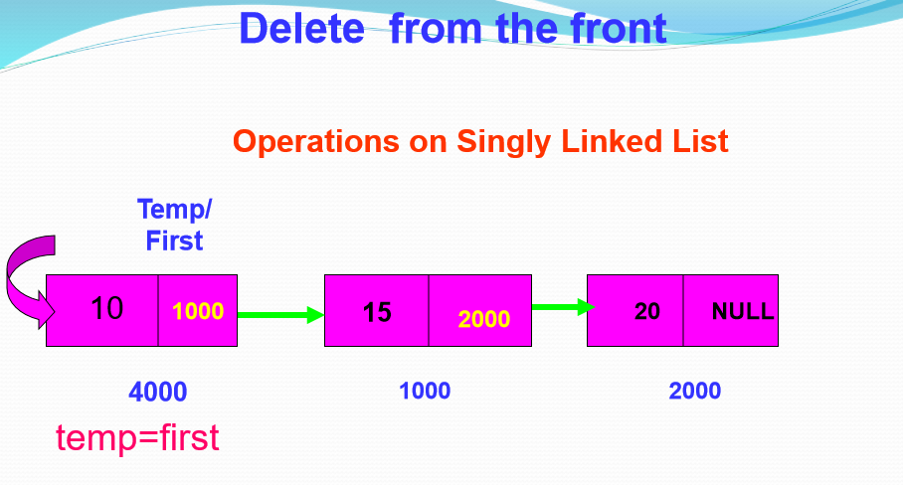

Slide 29
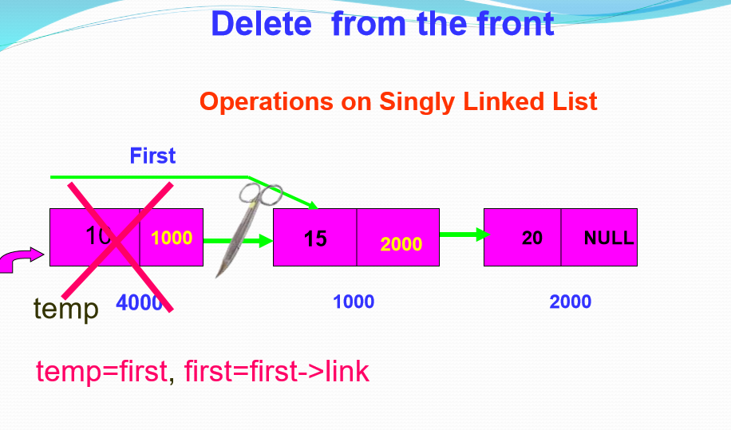

Slide 30
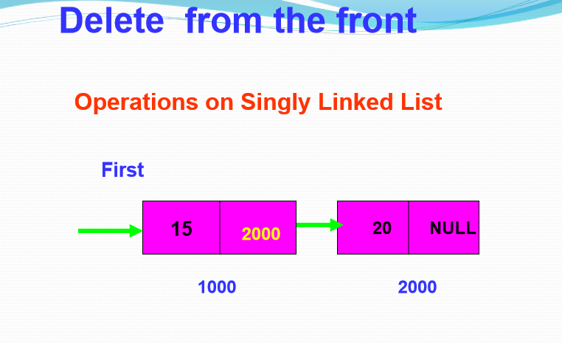

Slide 31
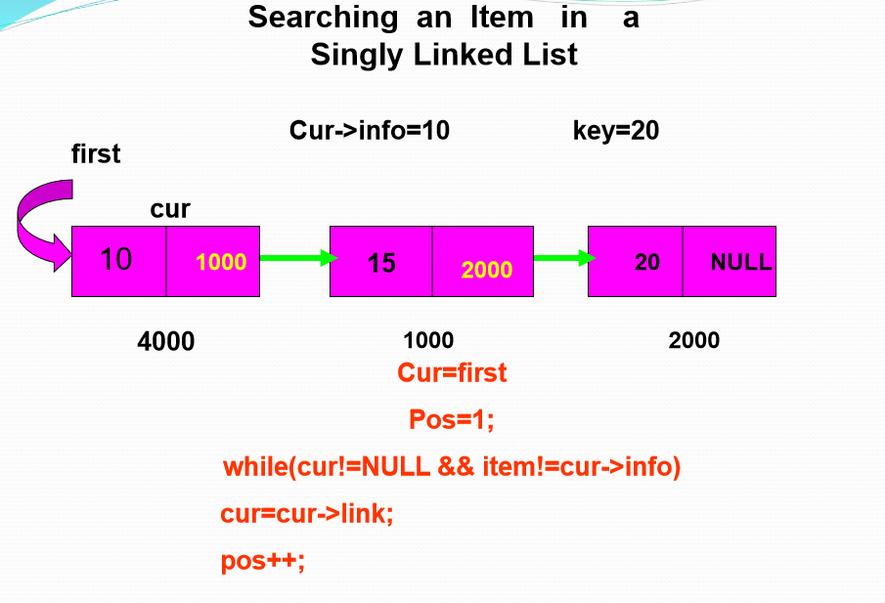

Slide 32
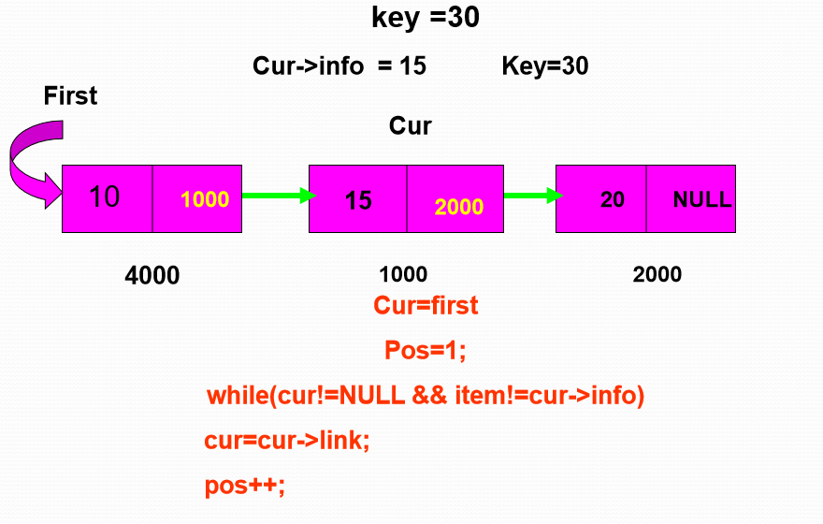
20
20

Slide 33
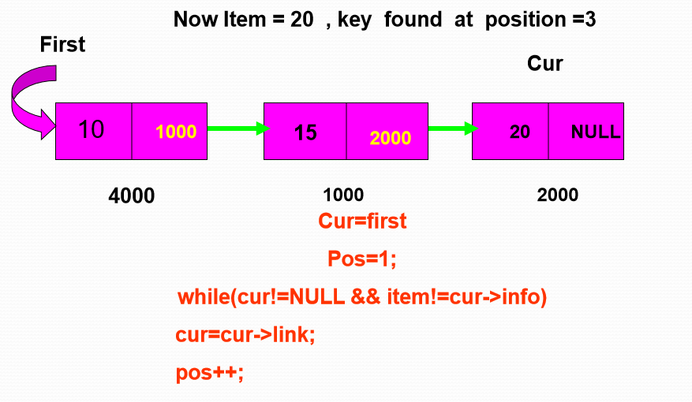

Slide 34
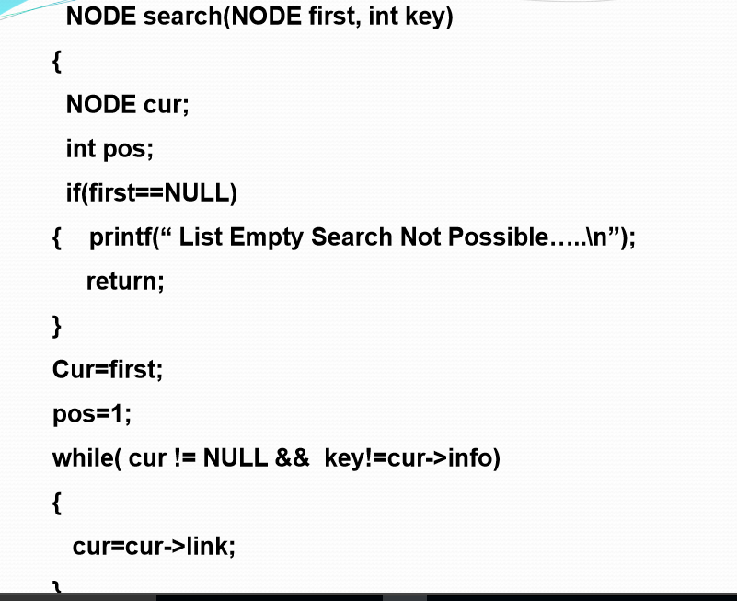
Function to search an item

Slide 35
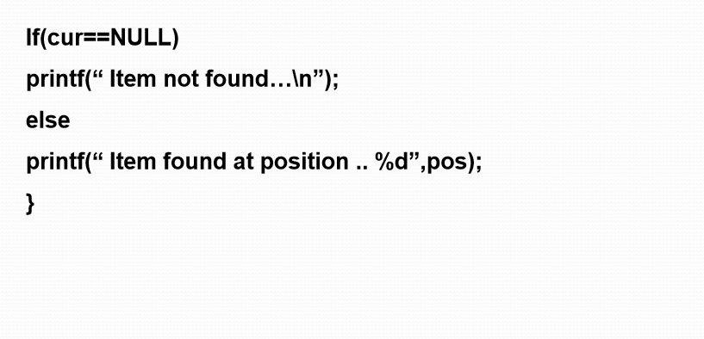

Slide 36
Linked list operations
Operations on Linked Lists
Refer Program here

Slide 37
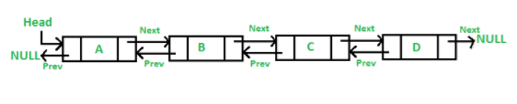
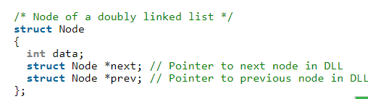
Doubly linked list
A Doubly Linked List (DLL) contains an extra pointer, typically called previous pointer, together with next pointer and data which are there in singly linked list.

Slide 38
Doubly linked list
Advantages over singly linked list 1) A DLL can be traversed in both forward and backward direction. 2) The delete operation in DLL is more efficient if pointer to the node to be deleted is given. In singly linked list, to delete a node, pointer to the previous node is needed. To get this previous node, sometimes the list is traversed. In DLL, we can get the previous node using previous pointer.
Disadvantages over singly linked list 1) Every node of DLL Require extra space for a previous pointer. 2) All operations require an extra pointer previous to be maintained. For example, in insertion, we need to modify previous pointers together with next pointers. For example in following functions for insertions at different positions, we need 1 or 2 extra steps to set previous pointer.

Slide 39
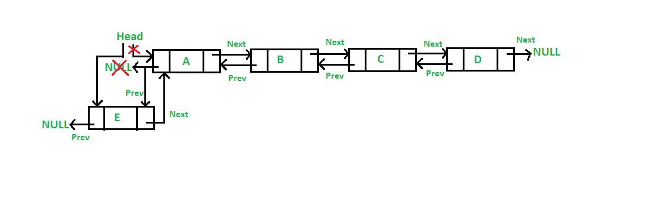
Insertion in doubly linked list
Insert a node at the front in a Doubly Linked List:
A new node is always added before the header of the given linked list. The task can be completed using the following 5 steps:
Firstly, allocate a new node (say new_node).
Now put the required data in the new node.
Make the next of new_node point to the current head of the doubly linked list.
Make the previous of the current head point to new_node.
Lastly, point head to new_node.
https://www.geeksforgeeks.org/introduction-and-insertion-in-a-doubly-linked-list/

Slide 40
Insertion in doubly linked list
// Given a reference (pointer to pointer) to the head of a list and an int, inserts a new node on the front of the list.
void push(struct Node** head_ref, int new_data)
{
// 1. allocate node
struct Node* new_node
= (struct Node*)malloc(sizeof(struct Node));
// 2. put in the data
new_node->data = new_data;
// 3. Make next of new node as head and previous as NULL
new_node->next = (*head_ref);
new_node->prev = NULL;
// 4. change prev of head node to new node
if ((*head_ref) != NULL)
(*head_ref)->prev = new_node;
// 5. move the head to point to the new node
(*head_ref) = new_node;
}

Slide 41
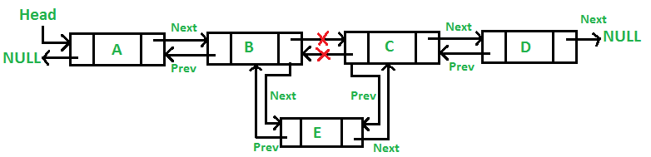
Insertion in doubly linked list
Add a node in between two nodes:
It is further classified into the following two parts:
Add a node after a given node in a Doubly Linked List:
We are given a pointer to a node as prev_node, and the new node is inserted after the given node. This can be done using the following 6 steps:
Firstly create a new node (say new_node).
Now insert the data in the new node.
Point the next of new_node to the next of prev_node.
Point the next of prev_node to new_node.
Point the previous of new_node to prev_node.
Change the pointer of the new node’s previous pointer to new_node.

Slide 42
Insertion in doubly linked list
To insert a node after a given node in the linked list: (Given a node as prev_node, insert a new node after the given node)
void insertAfter(struct Node* prev_node, int new_data)
{
// Check if the given prev_node is NULL
if (prev_node == NULL) {
printf("the given previous node cannot be NULL");
return;
}
// 1. allocate new node
struct Node* new_node
= (struct Node*)malloc(sizeof(struct Node));
// 2. put in the data
new_node->data = new_data;
// 3. Make next of new node as next of prev_node
new_node->next = prev_node->next;
// 4. Make the next of prev_node as new_node
prev_node->next = new_node;
// 5. Make prev_node as previous of new_node
new_node->prev = prev_node;
// 6. Change previous of new_node's next node
if (new_node->next != NULL)
new_node->next->prev = new_node;
}

Slide 43
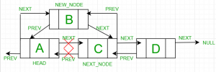
Insertion in doubly linked list
Add a node before a given node in a Doubly Linked List:
Let the pointer to this given node be next_node. This can be done using the following 6 steps.
Allocate memory for the new node, let it be called new_node.
Put the data in new_node.
Set the previous pointer of this new_node as the previous node of the next_node.
Set the previous pointer of the next_node as the new_node.
Set the next pointer of this new_node as the next_node.
Now set the previous pointer of new_node.
If the previous node of the new_node is not NULL, then set the next pointer of this previous node as new_node.
Else, if the prev of new_node is NULL, it will be the new head node.

Slide 44
Insertion in doubly linked list
// Given a node as prev_node, insert a new node after the given node
void insertBefore(struct Node* next_node, int new_data)
{
// Check if the given next_node is NULL
if (next_node == NULL) {
printf("the given next node cannot be NULL");
return;
}
// 1. Allocate new node
struct Node* new_node
= (struct Node*)malloc(sizeof(struct Node));
// 2. Put in the data
new_node->data = new_data;
// 3. Make previous of new node as previous of next_node
new_node->prev = next_node->prev;
// 4. Make the previous of next_node as new_node
next_node->prev = new_node;
// 5. Make next_node as next of new_node
new_node->next = next_node;
// 6. Change next of new_node's previous node
if (new_node->prev != NULL)
new_node->prev->next = new_node;
else
head = new_node;}

Slide 45
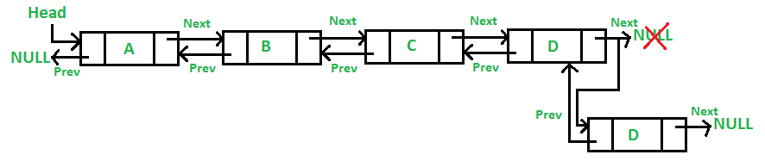
Insertion in doubly linked list
Insert a node at the end in a Doubly Linked List:
The new node is always added after the last node of the given Linked List. It can be done using the following 7 steps:
Create a new node (say new_node).
Put the value in the new node.
Make the next pointer of new_node as null.
If the list is empty, make new_node as the head.
Otherwise, travel to the end of the linked list.
Now make the next pointer of last node point to new_node.
Change the previous pointer of new_node to the last node of the list.

Slide 46
Insertion in doubly linked list
// Given a reference (pointer to pointer) to the head of a DLL and an int, appends a new node at the end
void append(struct Node** head_ref, int new_data)
{
// 1. allocate node
struct Node* new_node
= (struct Node*)malloc(sizeof(struct Node));
struct Node* last = *head_ref; /* used in step 5*/
// 2. put in the data
new_node->data = new_data;
// 3. This new node is going to be the last node, so
// make next of it as NULL
new_node->next = NULL;
// 4. If the Linked List is empty, then make the new
// node as head
if (*head_ref == NULL) {
new_node->prev = NULL;
*head_ref = new_node;
return;
}
// 5. Else traverse till the last node
while (last->next != NULL)
last = last->next;
// 6. Change the next of last node
last->next = new_node;
// 7. Make last node as previous of new node
new_node->prev = last;
return;}

Slide 47
Deletion in doubly linked list
We can delete an element in a list from:
From beginning
From end
From middle
Delete from End:
Point head to the previous element i.e. last second element
Change next pointer to null
struct node *end = head;
struct node *prev = NULL;
while(end->next)
{
prev = end;
end = end->next;
}
prev->next = NULL;
Make sure to free unused memory
free(end); or delete end;
Delete from Beginning:
Point head to the next node i.e. second node
temp = head
head = head->next
Make sure to free unused memory
free(temp); or delete temp;

Slide 48
Deletion in doubly linked list
Delete from Middle:
Keeps track of pointer before node to delete and pointer to node to delete
temp = head;
prev = head;
for(int i = 0; i < position; i++)
{
if(i == 0 && position == 1)
head = head->next;
free(temp)
else
{
if (i == position - 1 && temp)
{
prev->next = temp->next;
free(temp);
}
else
{
prev = temp;
if(prev == NULL) // position was greater than number of nodes in the list
break;
temp = temp->next; }}}

Slide 49
Doubly linked list operations
Refer Program here
Note: Doubly linked list operations like insertion at begin, insertion at end and insertion at middle are present in the attached code. You need to complete deletion at beginning, deletion at end and deletion at a position on your own

Slide 50
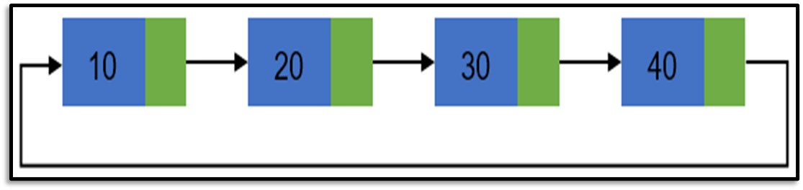
Circular linked list
In a circular linked list, the first node and the last node are linked together to form a circle. There is no NULL at the end.
Advantages of a Circular linked list
Entire list can be traversed from any node.
Circular lists are the required data structure when we want a list to be accessed in a circle or loop.
Despite of being singly circular linked list we can easily traverse to its previous node, which is not possible in singly linked list.
Disadvantages of Circular linked list
Circular list are complex as compared to singly linked lists.
Reversing of circular list is a complex as compared to singly or doubly lists.
If not traversed carefully, then we could end up in an infinite loop.
Like singly and doubly lists circular linked lists also doesn’t support direct accessing of elements.

Slide 51
Operations on circular linked list
Creation of list
Traversal of list
Insertion of node
At the beginning of list
At any position in the list
Deletion of node
Deletion of first node
Deletion of node from middle of the list
Deletion of last node
Counting total number of nodes
Reversing of list

Slide 52
Creation and Traversal of a Circular List
#include <stdio.h>
#include <stdlib.h>
/* Basic structure of Node */
struct node {
int data;
struct node * next;
}*head;
int main()
{
int n, data;
head = NULL;
printf("Enter the total number of nodes in list: ");
scanf("%d", &n);
createList(n); // function to create circular linked list
displayList(); // function to display the list
return 0;
}

Slide 53
Creation and Traversal of a Circular List
void createList(int n)
{
int i, data;
struct node *prevNode, *newNode;
if(n >= 1){ /* Creates and links the head node */
head = (struct node *)malloc(sizeof(struct node));
printf("Enter data of 1 node: ");
scanf("%d", &data);
head->data = data;
head->next = NULL;
prevNode = head;
for(i=2; i<=n; i++){ /* Creates and links rest of the n-1 nodes */
newNode = (struct node *)malloc(sizeof(struct node));
printf("Enter data of %d node: ", i);
scanf("%d", &data);
newNode->data = data;
newNode->next = NULL;
prevNode->next = newNode; //Links the previous node with newly created node
prevNode = newNode; //Moves the previous node ahead
}
prevNode->next = head; //Links the last node with first node
printf("\nCIRCULAR LINKED LIST CREATED SUCCESSFULLY\n");
}}

Slide 54
Circular Linked List: Traversal of List
void displayList()
{
struct node *current;
int n = 1;
if(head == NULL)
{
printf("List is empty.\n");
}
else
{
current = head;
printf("DATA IN THE LIST:\n");
do {
printf("Data %d = %d\n", n, current->data);
current = current->next;
n++;
}while(current != head);
}}

Slide 55
Representing a polynomial using a linked list
Store the coefficient and exponent of each term in nodes
int [] item1 = {5, 12}
int [] item2 = {2, 9}
int [] item3 = {-1, 3}
5 | 12
2 | 9
-1 | 3

Slide 56
Addition of two polynomials
Example:
Addition of the following polynomials
The results should be :

Slide 57
Addition of two Polynomials
Represent two polynomials in two linked lists l1 and l2
Create a third empty linked list l3
Compare the items in l1 with the items in l2, If there is no item having the same exponent, append these items to the third list. If there are two items with the same exponent exp and coefficient coff1 and coff2, append an item with exponent exp and coefficient coff1+coff2 to l3

Slide 58
Subtraction of two polynomials
Example:
Subtraction of the following polynomials
The results should be :

Slide 59
Subtraction of two polynomials
f(x) and g(x) are two polynomials. In order to solve f(x)-g(x):
Represent two polynomials in two linked lists (l1 for f(x) and l2 for g(x))
Create an empty linked lists l3 Negate the coefficient of all items in l2 and append these items to l3
Add l1 to l3 (Use algorithm: Addition of two polynomials)
Note: Write program for addition and subtraction of polynomials by your own

Slide 60
Multiplication of two Polynomials
f(x) and g(x) are two polynomials. In order to solve f(x)*g(x):
Represent two polynomials in two linked lists (l1 for f(x) and l2 for g(x))
For each item i in l1, multiply i with l2 and store the result in a new list. Add all the new lists together.
To multiply an item i with a list l. You need to multiply i with each item in l and store the results in a new list.
Multiply an item i (exp1, coff1)with an item j(exp2, coff2), you get an item k (exp1+exp2, coff1*coff2)

Slide 61
Application of Linked list: Polynomial Manipulation.
Polynomial Manipulation is one of the common application of linked list.
Representing and performing various basic operations on polynomials.
The basic structure of the linked list for polynomial manipulation is
// Structure representing a term in a polynomial
struct Term {
int coefficient;
int exponent;
struct Term* next;
};

Slide 62
Functions : Polynomial Manipulation .
Create node:
Allocates memory for a new term using malloc.
Initializes the coefficient and exponent fields with the provided data.
Sets the next pointer to NULL.
Returns a pointer to the newly created term.
struct Term* createTerm(int coefficient, int exponent) {
struct Term* newTerm = (struct Term*)malloc(sizeof(struct Term));
if (newTerm == NULL) {
// Handle memory allocation failure
printf("Memory allocation failed.\n");
exit(EXIT_FAILURE);
}
newTerm->coefficient = coefficient;
newTerm->exponent = exponent;
newTerm->next = NULL;
return newTerm;
}

Slide 63
Functions : Polynomial Manipulation .
Add Term:
Adds a new term to a polynomial.
If the polynomial is empty, sets the new term as the head.
void addTerm(struct Term** poly, int coefficient, int exponent) {
struct Term* newTerm = createTerm(coefficient, exponent);
if (*poly == NULL) {
*poly = newTerm;
} else {
struct Term* temp = *poly;
while (temp->next != NULL) {
temp = temp->next;
}
temp->next = newTerm;
}
}

Slide 64
Functions : Polynomial Manipulation .
Add Polynomials:
Adds two polynomials and returns the result.
Iterates through both polynomials, adding corresponding terms.
struct Term* addPolynomials(struct Term* poly1, struct Term* poly2) {
struct Term* result = NULL;
while (poly1 != NULL || poly2 != NULL) {
int coef1 = (poly1 != NULL) ? poly1->coefficient : 0;
int coef2 = (poly2 != NULL) ? poly2->coefficient : 0;
int exp1 = (poly1 != NULL) ? poly1->exponent : 0;
int exp2 = (poly2 != NULL) ? poly2->exponent : 0;
int sum_coef = coef1 + coef2;
addTerm(&result, sum_coef, exp1);
if (poly1 != NULL) poly1 = poly1->next;
if (poly2 != NULL) poly2 = poly2->next;
}
return result;
}

Slide 65
Functions : Polynomial Manipulation .
Display Polynomial:
Displays the elements of a polynomial.
Prints each term's coefficient and exponent.
Adds a plus sign between
terms for better readability.
void displayPolynomial(struct Term* poly) {
if (poly == NULL) {
printf("Polynomial is empty.\n");
return;
}
while (poly != NULL) {
printf("%dx^%d", poly->coefficient, poly->exponent);
if (poly->next != NULL) {
printf(" + ");
}
poly = poly->next;
}
printf("\n");
}

Slide 66
Merging of two sorted linked list
https://www.geeksforgeeks.org/dsa/merge-two-sorted-linked-lists/
https://dotnettutorials.net/lesson/how-to-merge-two-linked-lists/

Slide 67
Lab Experiments
Write a menu driven program for all the operations in case of singly linked list, circular singly linked list, doubly linked list, circular doubly linked list.
Insert at the beginning of the linked list
Insert at the end of the linked list
Insert at the given position of the linked list
Delete from the beginning of the linked list
Delete from the end of the linked list
Delete from the given position of the linked list
Search an element in a given linked list
Reversing a linked list
Merging two linked list
Traversing/ Display of linked list
Detect loop in a linked list (not in case of circular singly and circular doubly)

Slide 68
Lab Experiments
Write programs for the
Addition
Subtraction
Multiplication
of two polynomials using linked lists

Slide 69
Practice MCQ questions on Linked List
https://www.geeksforgeeks.org/data-structure-gq/top-mcqs-on-linked-list-data-structure-with-answers/

Slide 70
Top 50 Problems on Linked List Data Structure asked in SDE Interviews
https://www.geeksforgeeks.org/top-20-linked-list-interview-question/

Slide 71
Real life examples of different types of linked list
Singly Linked List: Example: Imagine a playlist in a music player. Each song is a node in the singly linked list, and each node contains information about the song and a reference to the next song in the playlist.
Node 1 Node 2 Node 3
+---------+ +---------+ +---------+
| Song 1 | -> | Song 2 | -> | Song 3 |
+---------+ +---------+ +---------+
Doubly Linked List: Example: Consider a browser history where each webpage is a node. In a doubly linked list, each node has a reference to the previous and next pages.
+---------+ +---------+ +---------+
(null) <- | Page 1 | <-> | Page 2 | <-> | Page 3 | -> (null)
+---------+ +---------+ +---------+

Slide 72
Singly Circular Linked List: Example: A round-robin scheduling algorithm in operating systems. The process queue is implemented as a singly circular linked list. After the last process, it cycles back to the first process.
+---------+ +---------+ +---------+
| Process1| -> | Process2| -> | Process3|
+---------+ +---------+ +---------+
^ |
|-----------------------------------|
Doubly Circular Linked List: Example: A deck of cards in a card game where each card is a node. It's a doubly circular linked list because you can navigate forward and backward through the deck, and after the last card, it cycles back to the first card.
+---------+ +---------+ +---------+
<->| Card1 | <->| Card2 | <->| Card3 | <->
+---------+ +---------+ +---------+
| |
+-----------------------------------+

Slide 73
Applications of linked list
Polynomial manipulation
Support for other data structures: Some other data structures like stacks, queues, hash tables, graphs can be implemented using a linked list.
Memory Management: Memory management is one of the operating system's key features. It decides how to allocate and reclaim storage for processes running on the system. We can use a linked list to keep track of portions of memory available for allocation.
Linked allocation of files: A file of large size may not be stored in one place on a disk. So there must be some mechanism to link all the scattered parts of the file together. The use of a linked list allows an efficient file allocation method in which each block of a file contains a pointer to the file's text block. But this method is good only for sequential access.

Slide 74
Header Linked list
https://www.geeksforgeeks.org/header-linked-list-in-c/

Slide 75
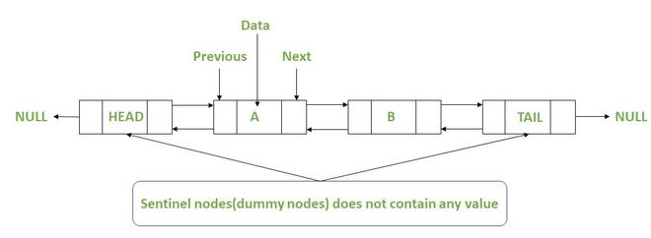
Sentinel Node
Sentinel nodes are specially designed nodes that do not hold or refer to any data of the linked list.
To make insertion and deletion operations in a linked-linked list simple, we have to add one sentinel node at the beginning of the linked list and one at the end of the linked list, as shown in the below diagram.

Slide 76
Doubly Linked List: Sentinel or “dummy nodes
When implementing a doubly linked lists, we add two special nodes to the ends of the lists: the header and trailer nodes.
The header node goes before the first list element. It has a valid next link but a null prev link.
The trailer node goes after the last element. It has a valid prev reference but a null next reference.
NOTE: the header and trailer nodes are sentinel or “dummy” nodes because they do not store elements. Here’s a diagram of our doubly
linked list:

Slide 77
Advantages of Sentinel node:
The most significant advantage of using the sentinel nodes in the linked list:
By adding the sentinel nodes to the doubly linked list now for the deletion or insertion at the beginning, end or in between the beginning and end nodes of the linked list, we do not need to write the different conditions for each one.
All these operations can be done as the deletion or insertion between the beginning and end node of a doubly linked list.

Slide 78
Skip List
https://www.geeksforgeeks.org/skip-list/
A skip list is a data structure that allows for efficient search, insertion and deletion of elements in a sorted list. It is a probabilistic data structure, meaning that its average time complexity is determined through a probabilistic analysis.
In a skip list, elements are organized in layers, with each layer having a smaller number of elements than the one below it. The bottom layer is a regular linked list, while the layers above it contain “skipping” links that allow for fast navigation to elements that are far apart in the bottom layer. The idea behind this is to allow for quick traversal to the desired element, reducing the average number of steps needed to reach it.
Skip lists are implemented using a technique called “coin flipping.” In this technique, a random number is generated for each insertion to determine the number of layers the new element will occupy. This means that, on average, each element will be in log(n) layers, where n is the number of elements in the bottom layer.
Skip lists have an average time complexity of O(log n) for search, insertion and deletion, which is similar to that of balanced trees, such as AVL trees and red-black trees, but with the advantage of simpler implementation and lower overhead.

Slide 79
Skip List.
Based on the concept of simple linked list.
Elements are organized in layers.
Bottom layer is the regular linked list.
Rest of the lists having fewer elements than the bottom list.
No new element is added in the list layers.
Node structure is shown below
struct Node {
int data;
struct Node* next[MAX_LEVEL];
}; //MAX_LEVEL defining the number of layers

Slide 80


Slide 81
Can we search in a sorted linked list better than O(n) time?
The worst-case search time for a sorted linked list is O(n) as we can only linearly traverse the list and cannot skip nodes while searching. For a Balanced Binary Search Tree, we skip almost half of the nodes after one comparison with the root. For a sorted array, we have random access and we can apply Binary Search on arrays. Can we augment sorted linked lists to search faster? The answer is Skip List. The idea is simple, we create multiple layers so that we can skip some nodes. See the following example list with 16 nodes and two layers. The upper layer works as an “express lane” that connects only the main outer stations, and the lower layer works as a “normal lane” that connects every station. Suppose we want to search for 50, we start from the first node of the “express lane” and keep moving on the “express lane” till we find a node whose next is greater than 50. Once we find such a node (30 is the node in the following example) on “express lane”, we move to “normal lane” using a pointer from this node, and linearly search for 50 on “normal lane”. In the following example, we start from 30 on the “normal lane” and with linear search, we find 50.

Slide 82

Generalized linked list
https://www.geeksforgeeks.org/generalized-linked-list/
A Generalized Linked List L, is defined as a finite sequence of n>=0 elements, l₁, l₂, l₃, l₄, …, l_{n}, such that l_{i} are either item or the list of items. Thus L = (l₁, l₂, l₃, l₄, …, l_{n}) where n is total number of nodes in the list.

Slide 83
To represent a list of items there are certain assumptions about the node structure.
Flag = 1 implies that down pointer exists
Flag = 0 implies that next pointer exists
Data means the item.
Down pointer is the address of node which is down of the current node
Next pointer is the address of node which is attached as the next node

Slide 84

Why Generalized Linked List?
Generalized linked lists are used because although the efficiency of polynomial operations using linked list is good but still, the disadvantage is that the linked list is unable to use multiple variable polynomial equation efficiently. It helps us to represent multi-variable polynomial along with the list of elements.
When first field is 0, it indicates that the second field is variable. If first field is 1 means the second field is a down pointer, means some list is starting.

Slide 85

Polynomial Representation using Generalized Linked List
The typical node structure will be:
Here Flag = 0 means variable is present
Flag = 1 means down pointer is present
Flag = 2 means coefficient and exponent is present

Slide 86


Slide 87

-4x⁴y²z³ + 10x²yz² +7xyz +45

